Slide 1
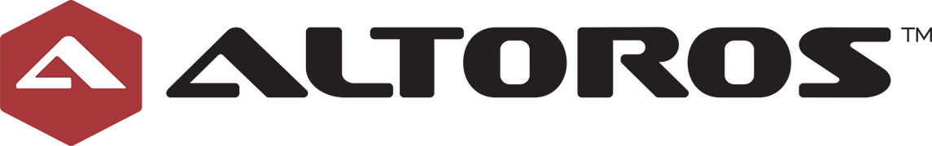
Cloud Foundry Overview

Slide 2
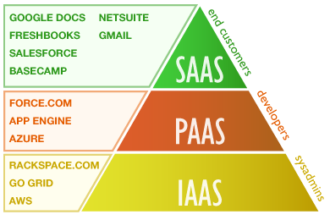
Cloud computing
Notes:
goal:
single platform for all devices
Increase quality and reduce the amount of stabilization
reduce planning.
PaaS is good fit for Project automatization
tests should be small.

Slide 3
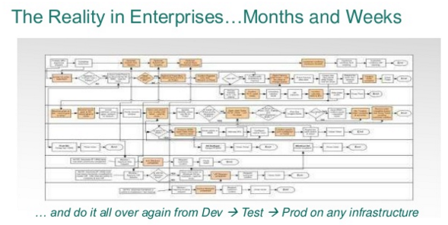
Notes:
goal:
single platform for all devices
Increase quality and reduce the amount of stabilization
reduce planning.
PaaS is good fit for Project automatization
tests should be small.

Slide 4
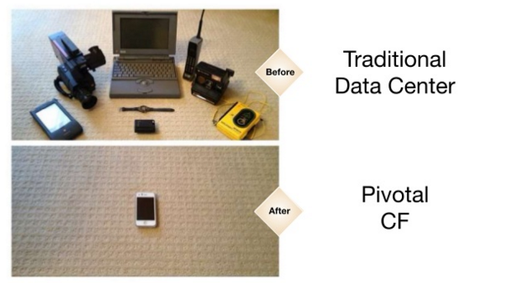
The Key Benefits of PaaS for Developers
Simplifying of business processes
Notes:
goal:
single platform for all devices
Increase quality and reduce the amount of stabilization
reduce planning.
PaaS is good fit for Project automatization
tests should be small.

Slide 5
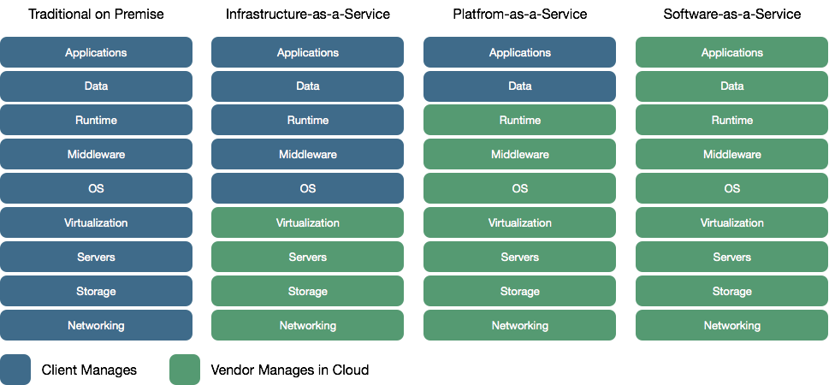
Cloud Delivery Model
Notes:
goal:
single platform for all devices
Increase quality and reduce the amount of stabilization
reduce planning.
PaaS is good fit for Project automatization
tests should be small.

Slide 6
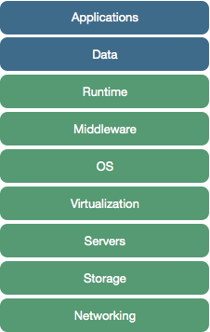

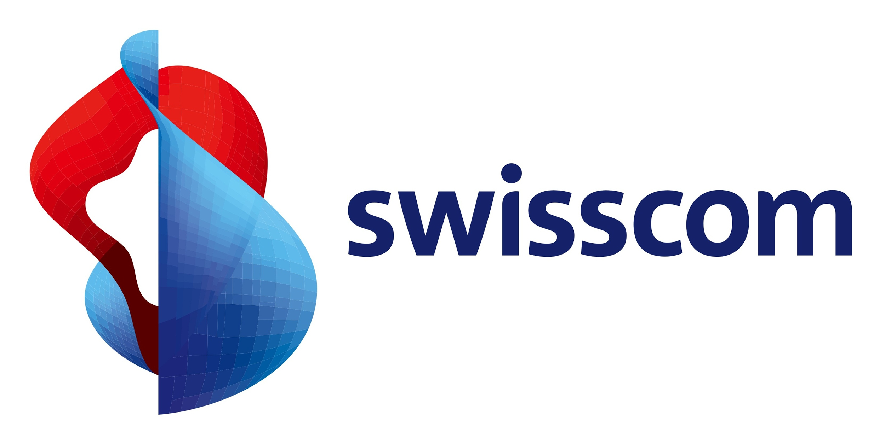
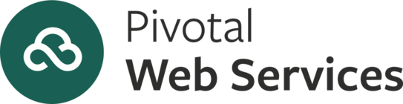

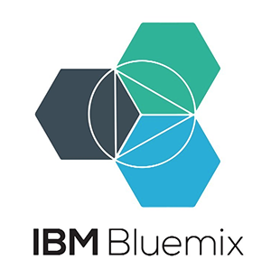
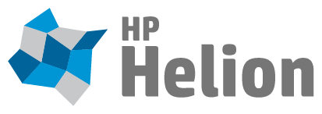
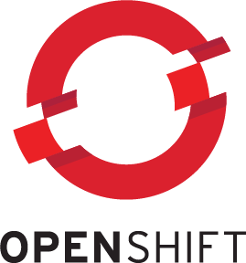
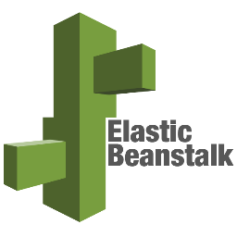
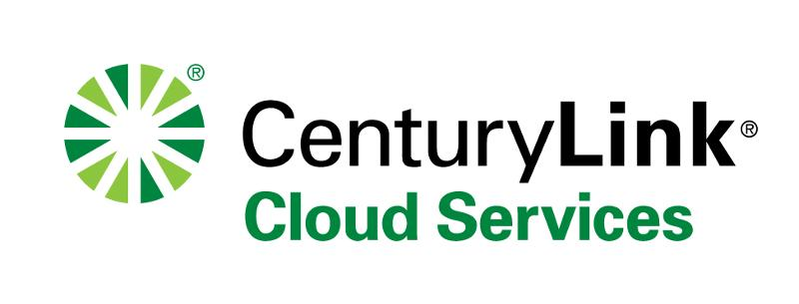

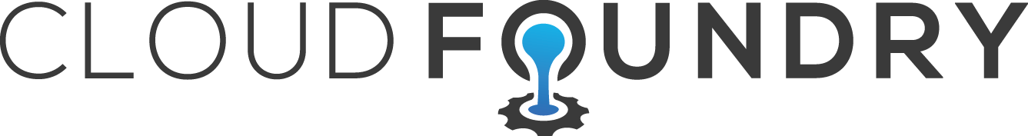
Platfrom-as-a-Service
Notes:
goal:
single platform for all devices
Increase quality and reduce the amount of stabilization
reduce planning.
PaaS is good fit for Project automatization
tests should be small.

Slide 7
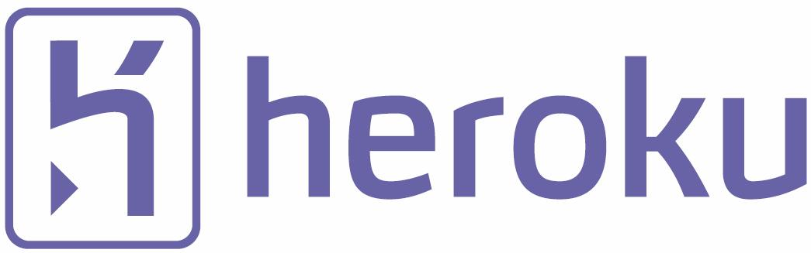
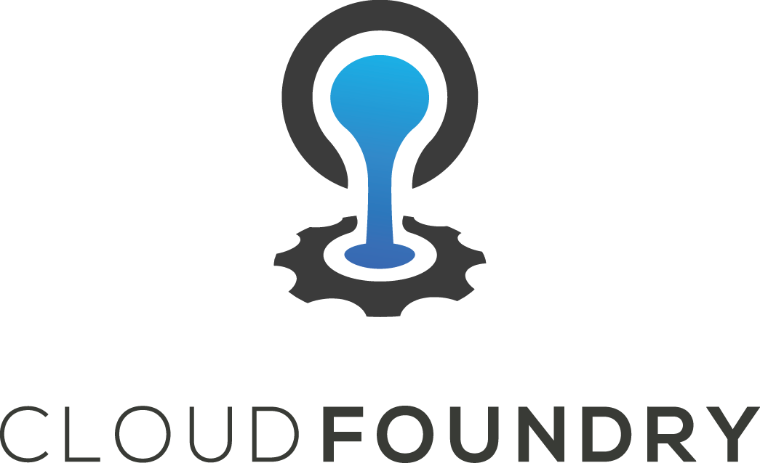
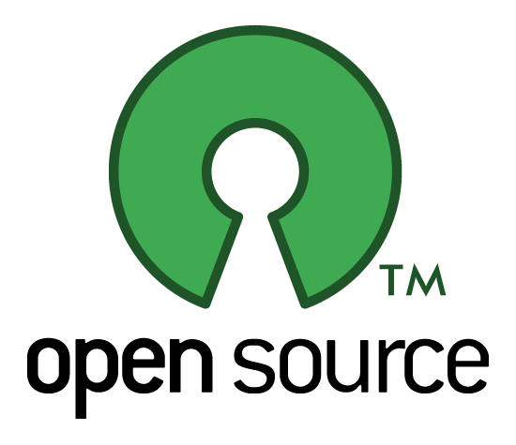
What Is Cloud Foundry?
Notes:
goal:
single platform for all devices
Increase quality and reduce the amount of stabilization
reduce planning.
PaaS is good fit for Project automatization
tests should be small.

Slide 8
Features
Simplified App Build & Deploy Cycles
Powerful Tools for Operations and Monitoring
Highly Extensible
Platform Independent
Fast & Stable Continuous Development
One of the Best Open Source Communities
Notes:
goal:
single platform for all devices
Increase quality and reduce the amount of stabilization
reduce planning.
PaaS is good fit for Project automatization
tests should be small.

Slide 9
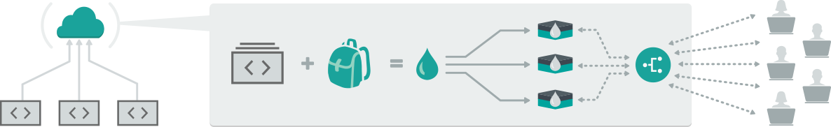
Simple
Upload cf push uploads your files to the platform which transforms them a running application. | Stage Behind the scenes, your files go through staging scripts called buildpacks to create a ready-to-run droplet. | Distribute Diego runs the droplets in containers, calls a start command and notifies that your app instances are ready to receive traffic. | Run Your app receives an entry in a dynamic routing tier, which load balances traffic across all your app instances.
Notes:
goal:
single platform for all devices
Increase quality and reduce the amount of stabilization
reduce planning.
PaaS is good fit for Project automatization
tests should be small.

Slide 10
Ideal For… Developers
Forget About Infrastructure
Fast & Secure Deployment Methods
Same workflow of deployment and implementation for testing & production
Support for a wide range of stacks from the base installation (Ruby, nodejs, Java, Golang, Python, PHP)
Dynamic Binding of Services
Fault Tolerant Apps
Built in scalability
Notes:
goal:
single platform for all devices
Increase quality and reduce the amount of stabilization
reduce planning.
PaaS is good fit for Project automatization
tests should be small.

Slide 11
Ideal For… DevOps
Release Engineering Stable, Predictable & Self-Healing.
IaaS Independent (Almost)
Fault Tolerance in almost all components (Database is the exception).
Fast fix of security issues
All components provided by the same community (cf-release, bosh, stemcells)
Great support from community (Specially from mailing list - vcap-dev, bosh-dev, bosh-users)
Notes:
goal:
single platform for all devices
Increase quality and reduce the amount of stabilization
reduce planning.
PaaS is good fit for Project automatization
tests should be small.

Slide 12
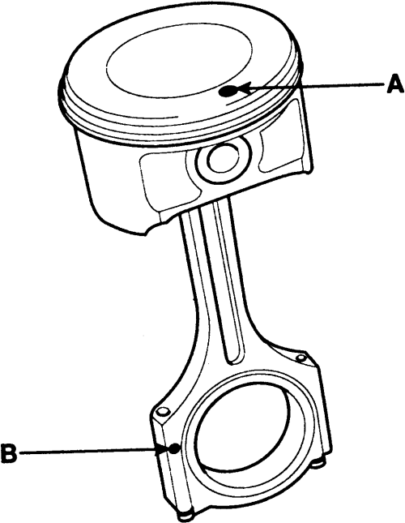
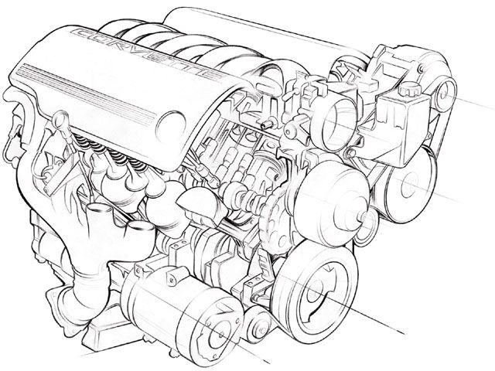
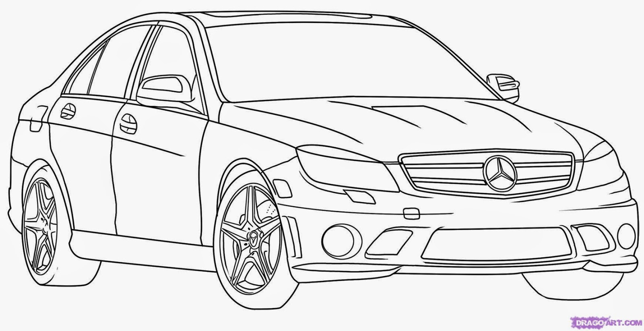
Cloud Foundry vs...
Container
Orchestration
Platform
Docker
Rocket
Garden (CF)
Kubernetes
Swarm
Fleet
Nomad
Diego - CC (CF)
OpenShift
Google App Engine
Deis
Cloud Foundry

Slide 13

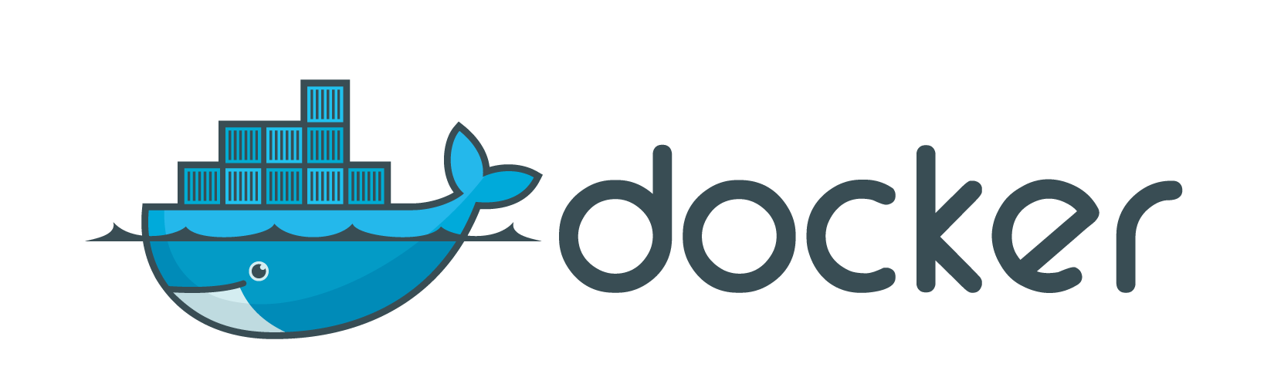
DEA - Diego - Docker!
Notes:
A DEA (Droplet Execution Agent) uses Warden to create a secure and fully isolated container – a DEA can run one or multiple apps each one of this inside its own warden container. DEAs are responsible for an app’s lifecycle: Buildpacks create app droplets which execute on a warden container inside the DEA. As today release (v183) the standard buildpacks are:
Go
Java
Ruby
Python
PHP
nodejs

Slide 14
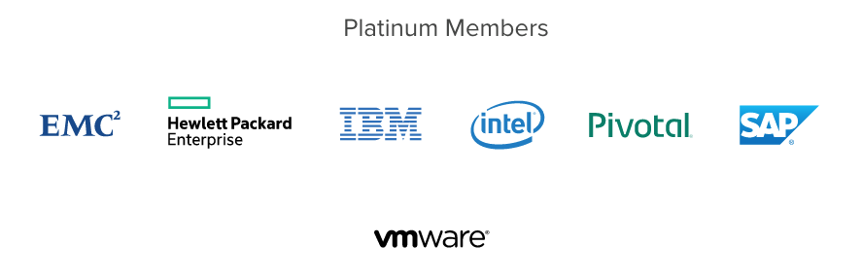
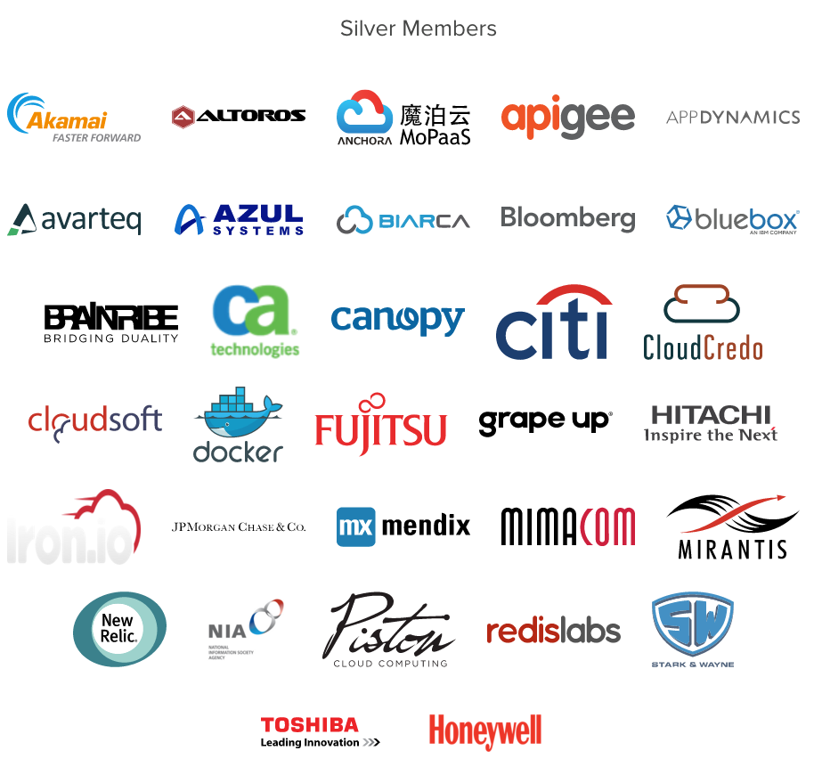
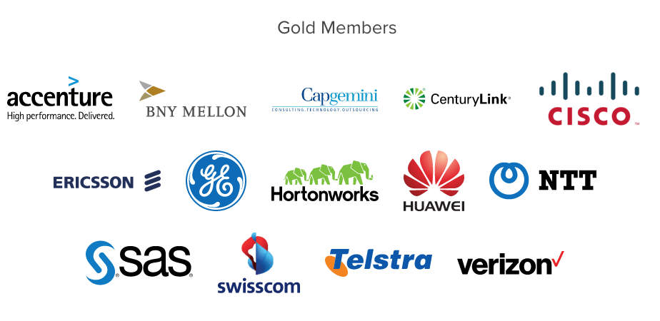
What is the Cloud Foundry Foundation
Notes:
goal:
single platform for all devices
Increase quality and reduce the amount of stabilization
reduce planning.
PaaS is good fit for Project automatization
tests should be small.

